Slide 1
PHYSICAL COMPUTING
WEEK 02
Notes:
he played a huge role in remote control, induction motors, ac power, radio waves, xrays, wireless telecommunication,
http://theoatmeal.com/comics/tesla
When wireless is perfectly applied the whole earth will be converted into a huge brain, which in fact it is, all things being particles of a real and rhythmic whole. We shall be able to communicate with one another instantly, irrespective of distance. Not only this, but through television and telephony we shall see and hear one another as perfectly as though we were face to face, despite intervening distances of thousands of miles; and the instruments through which we shall be able to do this will be amazingly simple compared with our present telephone. A man will be able to carry one in his vest pocket.

Slide 2
a word about
TESTING AND DEBUGGING
Notes:
he played a huge role in remote control, induction motors, ac power, radio waves, xrays, wireless telecommunication,
http://theoatmeal.com/comics/tesla
When wireless is perfectly applied the whole earth will be converted into a huge brain, which in fact it is, all things being particles of a real and rhythmic whole. We shall be able to communicate with one another instantly, irrespective of distance. Not only this, but through television and telephony we shall see and hear one another as perfectly as though we were face to face, despite intervening distances of thousands of miles; and the instruments through which we shall be able to do this will be amazingly simple compared with our present telephone. A man will be able to carry one in his vest pocket.

Slide 3
WHEN TO EMAIL ME
1. Did you run a google search and read the results?
2. Did you ask your friends in class?
3. Did you post on the student forums?
4. Did you search the arduino forums? http://forum.arduino.cc/
5. Did you post to the arudino forums and give it a few hours?
5. Did you walk away from the problem then try again it?
Still stuck? Email.
If I can find your problem on the first page of google, I’m not going to reply.
Not because I don’t like you but because this is poor, poor dev practice.
Notes:
he played a huge role in remote control, induction motors, ac power, radio waves, xrays, wireless telecommunication,
http://theoatmeal.com/comics/tesla
When wireless is perfectly applied the whole earth will be converted into a huge brain, which in fact it is, all things being particles of a real and rhythmic whole. We shall be able to communicate with one another instantly, irrespective of distance. Not only this, but through television and telephony we shall see and hear one another as perfectly as though we were face to face, despite intervening distances of thousands of miles; and the instruments through which we shall be able to do this will be amazingly simple compared with our present telephone. A man will be able to carry one in his vest pocket.

Slide 4
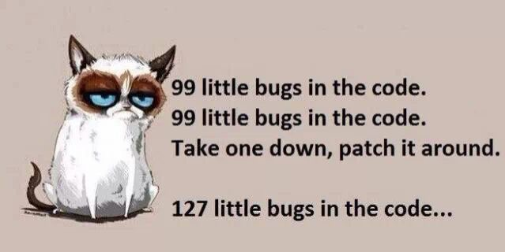
IF YOU LEARN ONLY ONE SKILL IN COLLEGE,
LEARN TO FIND YOUR OWN ANSWERS THROUGH DEBUGGING.
Notes:
he played a huge role in remote control, induction motors, ac power, radio waves, xrays, wireless telecommunication,
http://theoatmeal.com/comics/tesla
When wireless is perfectly applied the whole earth will be converted into a huge brain, which in fact it is, all things being particles of a real and rhythmic whole. We shall be able to communicate with one another instantly, irrespective of distance. Not only this, but through television and telephony we shall see and hear one another as perfectly as though we were face to face, despite intervening distances of thousands of miles; and the instruments through which we shall be able to do this will be amazingly simple compared with our present telephone. A man will be able to carry one in his vest pocket.

Slide 5
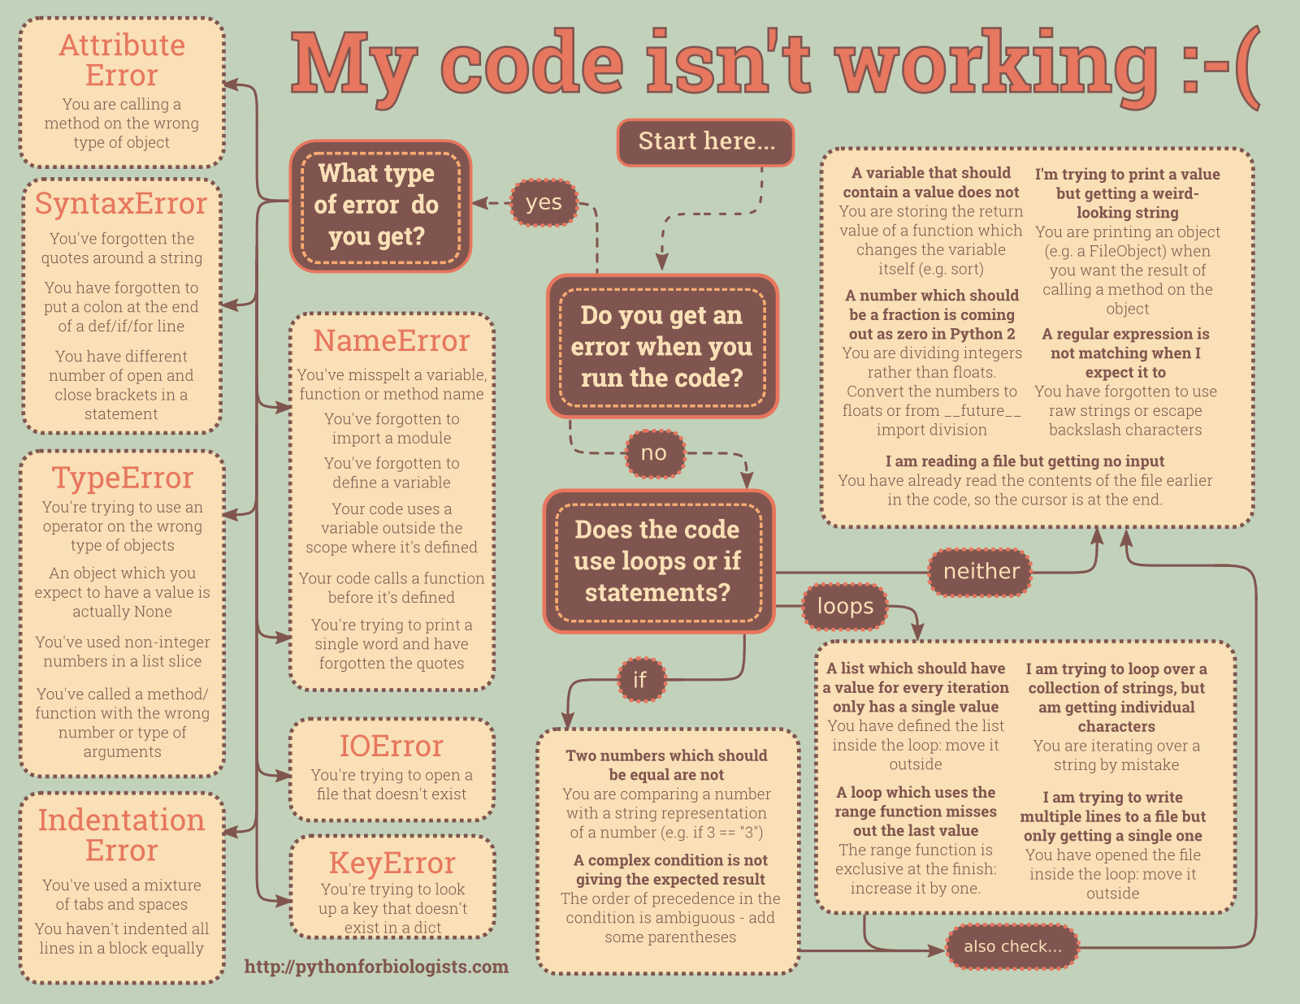
Notes:
he played a huge role in remote control, induction motors, ac power, radio waves, xrays, wireless telecommunication,
http://theoatmeal.com/comics/tesla
When wireless is perfectly applied the whole earth will be converted into a huge brain, which in fact it is, all things being particles of a real and rhythmic whole. We shall be able to communicate with one another instantly, irrespective of distance. Not only this, but through television and telephony we shall see and hear one another as perfectly as though we were face to face, despite intervening distances of thousands of miles; and the instruments through which we shall be able to do this will be amazingly simple compared with our present telephone. A man will be able to carry one in his vest pocket.

Slide 6
Sensors and actuators
INPUT AND OUTPUT
Notes:
he played a huge role in remote control, induction motors, ac power, radio waves, xrays, wireless telecommunication,
http://theoatmeal.com/comics/tesla
When wireless is perfectly applied the whole earth will be converted into a huge brain, which in fact it is, all things being particles of a real and rhythmic whole. We shall be able to communicate with one another instantly, irrespective of distance. Not only this, but through television and telephony we shall see and hear one another as perfectly as though we were face to face, despite intervening distances of thousands of miles; and the instruments through which we shall be able to do this will be amazingly simple compared with our present telephone. A man will be able to carry one in his vest pocket.

Slide 7
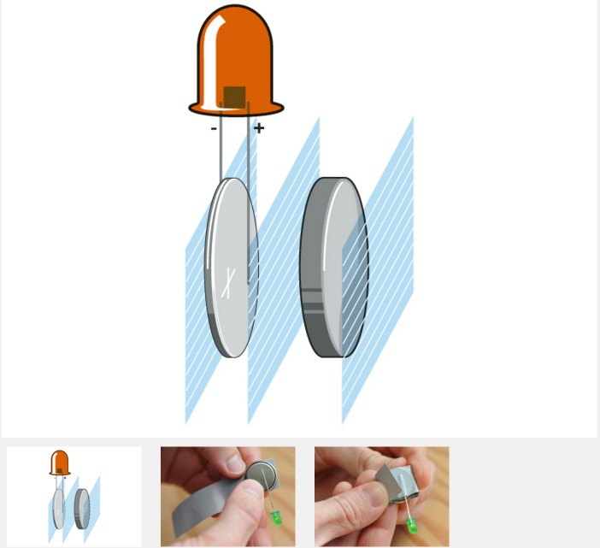
https://www.youtube.com/watch?v=m6kJsdkZEIQ
Notes:
he played a huge role in remote control, induction motors, ac power, radio waves, xrays, wireless telecommunication,
http://theoatmeal.com/comics/tesla
When wireless is perfectly applied the whole earth will be converted into a huge brain, which in fact it is, all things being particles of a real and rhythmic whole. We shall be able to communicate with one another instantly, irrespective of distance. Not only this, but through television and telephony we shall see and hear one another as perfectly as though we were face to face, despite intervening distances of thousands of miles; and the instruments through which we shall be able to do this will be amazingly simple compared with our present telephone. A man will be able to carry one in his vest pocket.

Slide 8
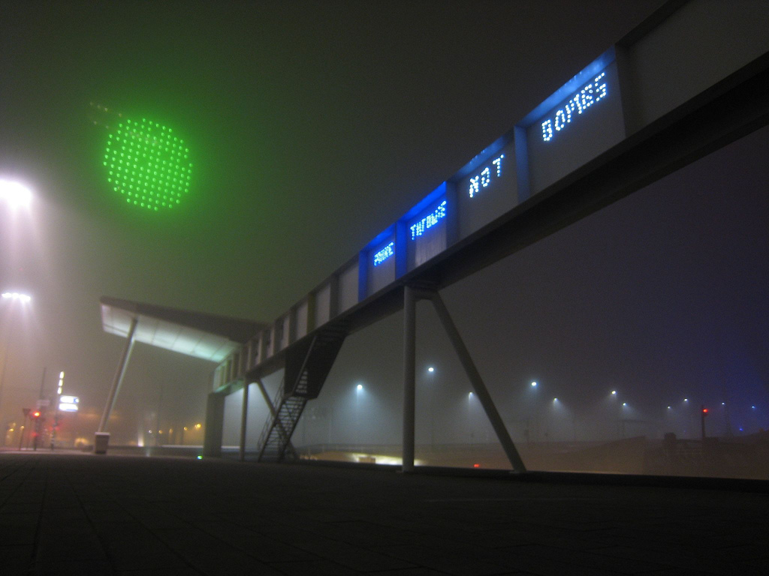
Notes:
he played a huge role in remote control, induction motors, ac power, radio waves, xrays, wireless telecommunication,
http://theoatmeal.com/comics/tesla
When wireless is perfectly applied the whole earth will be converted into a huge brain, which in fact it is, all things being particles of a real and rhythmic whole. We shall be able to communicate with one another instantly, irrespective of distance. Not only this, but through television and telephony we shall see and hear one another as perfectly as though we were face to face, despite intervening distances of thousands of miles; and the instruments through which we shall be able to do this will be amazingly simple compared with our present telephone. A man will be able to carry one in his vest pocket.

Slide 9
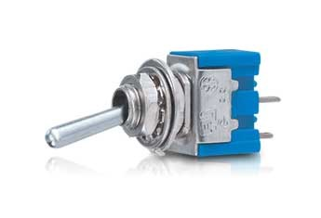
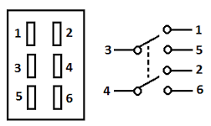
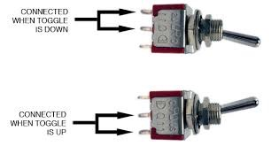
BUTTONS
Poles - primary contact
Throws - number of switches active at a given time
2p2t
1p1t
on
2p1t
on or off
And so on…
Notes:
he played a huge role in remote control, induction motors, ac power, radio waves, xrays, wireless telecommunication,
http://theoatmeal.com/comics/tesla
When wireless is perfectly applied the whole earth will be converted into a huge brain, which in fact it is, all things being particles of a real and rhythmic whole. We shall be able to communicate with one another instantly, irrespective of distance. Not only this, but through television and telephony we shall see and hear one another as perfectly as though we were face to face, despite intervening distances of thousands of miles; and the instruments through which we shall be able to do this will be amazingly simple compared with our present telephone. A man will be able to carry one in his vest pocket.

Slide 10
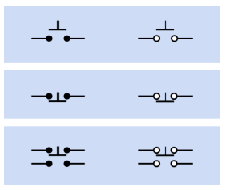
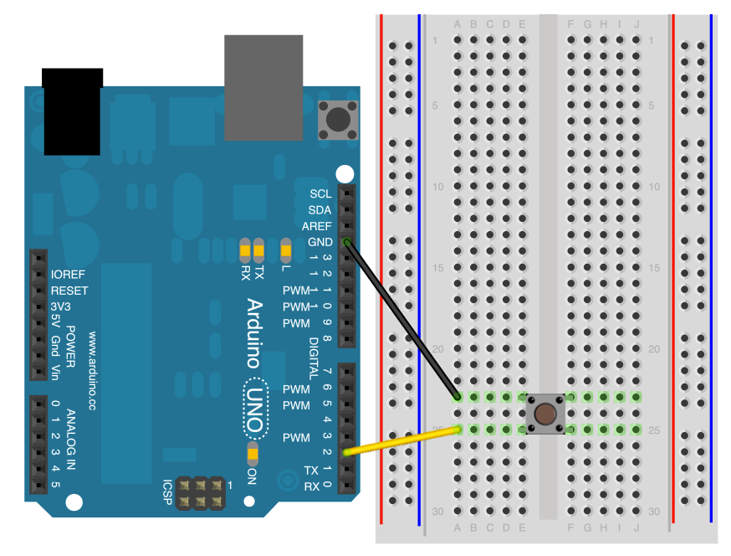
THE PUSH BUTTON
a single pushbutton may close
or open two separate pairs of contacts

Slide 11
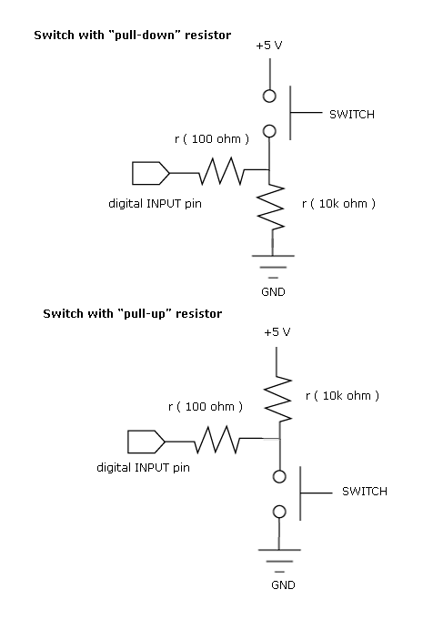
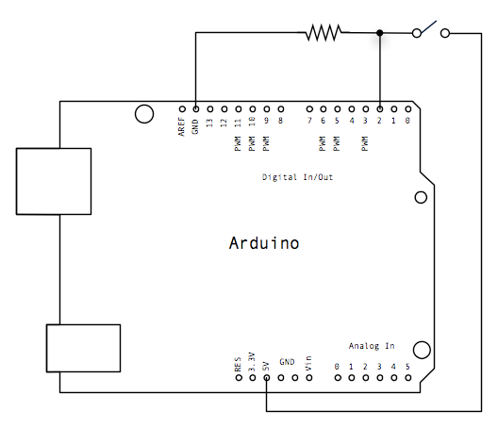
Current flows down the
path of least resistance

Slide 12
digitalRead(pinNumber)
se this function to measure
a closed (or open) connection

Slide 13
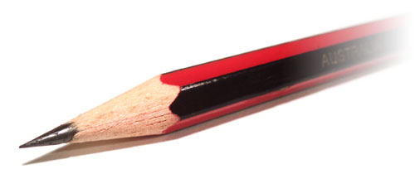
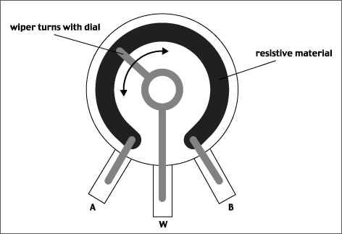
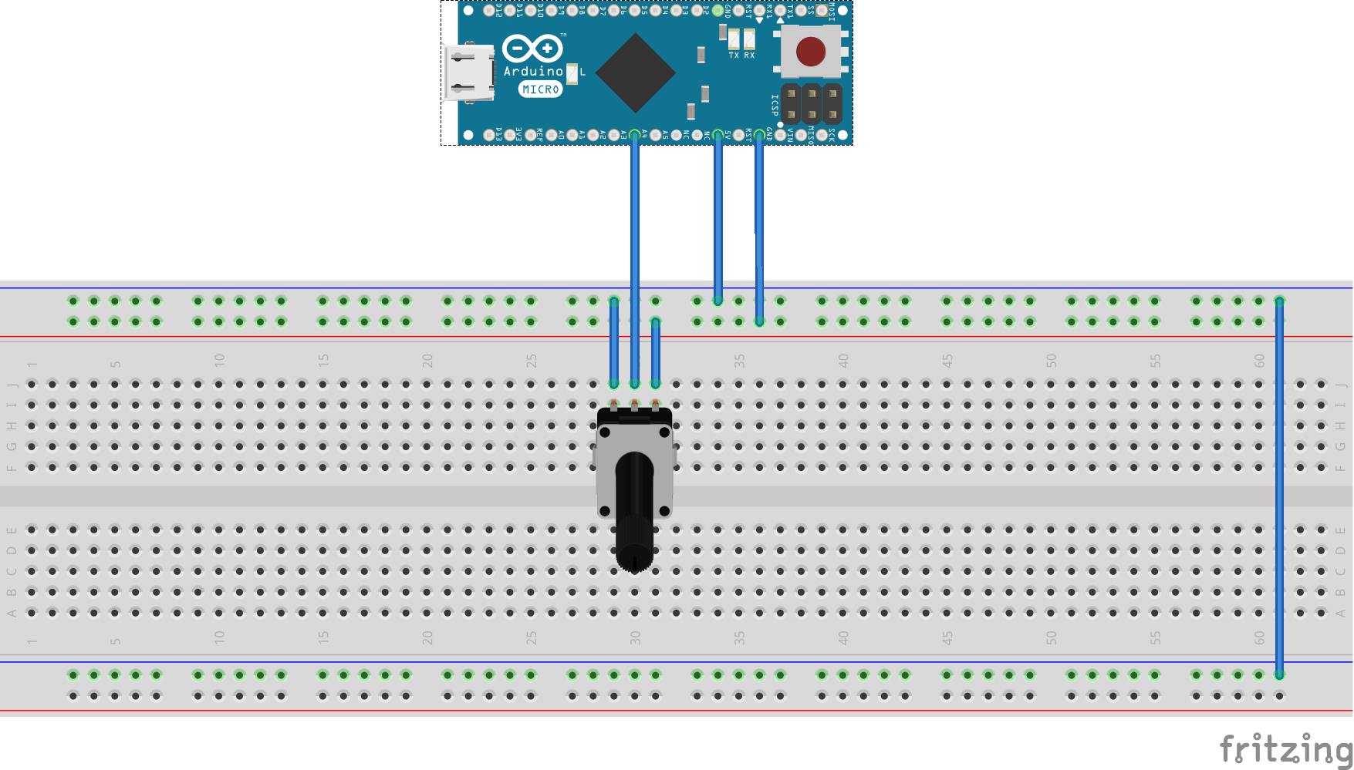
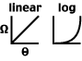
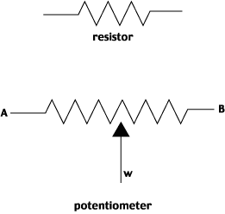
THE POTENTIOMETER
A variable resistor

Slide 14
ALL YOU NEED IS A WAY TO MEASURE THAT CHANGE
AND THAT’S WHAT YOU CAN DO WITH A MICRO CONTROLLER.

Slide 15
analogRead(pinNumber)
use this function to measure resistance

Slide 16
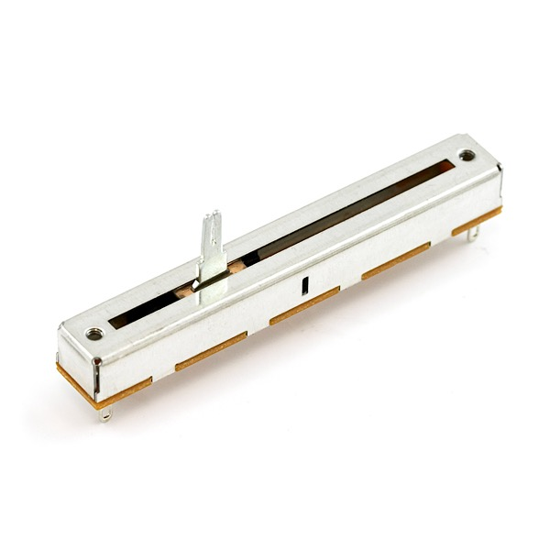
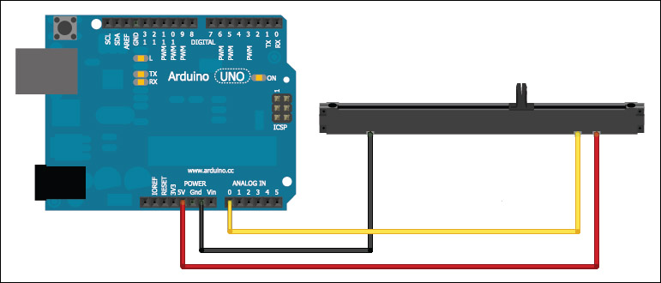
THE SLIDER
A sideways potentiometer

Slide 17
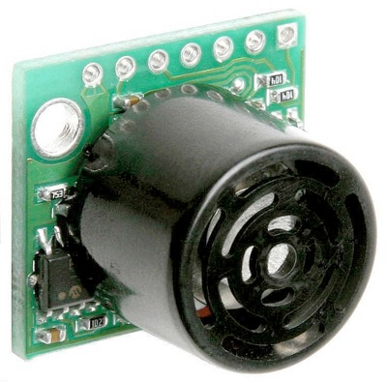
There are many different kinds of sensors
ir
light
sonar (proximity)
sound
touch
bend
Notes:
this movement is largely problematic and it’s being hugely co-opted at the present moment

Slide 18
mostly they change
resistance in some way
Notes:
he played a huge role in remote control, induction motors, ac power, radio waves, xrays, wireless telecommunication,
http://theoatmeal.com/comics/tesla
When wireless is perfectly applied the whole earth will be converted into a huge brain, which in fact it is, all things being particles of a real and rhythmic whole. We shall be able to communicate with one another instantly, irrespective of distance. Not only this, but through television and telephony we shall see and hear one another as perfectly as though we were face to face, despite intervening distances of thousands of miles; and the instruments through which we shall be able to do this will be amazingly simple compared with our present telephone. A man will be able to carry one in his vest pocket.

Slide 19
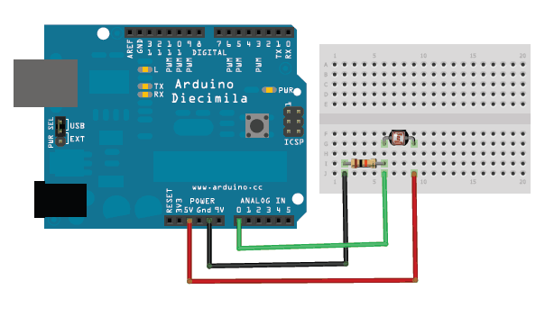
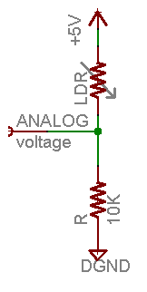
THE LDR
A variable resistor

Slide 20
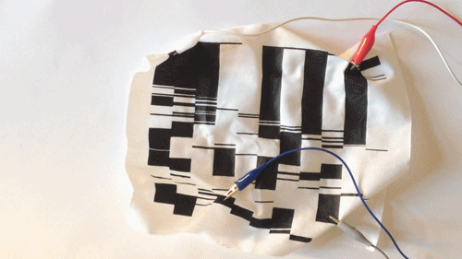
Some examples of sensors in the world
https://vimeo.com/105146759
Notes:
he played a huge role in remote control, induction motors, ac power, radio waves, xrays, wireless telecommunication,
http://theoatmeal.com/comics/tesla
When wireless is perfectly applied the whole earth will be converted into a huge brain, which in fact it is, all things being particles of a real and rhythmic whole. We shall be able to communicate with one another instantly, irrespective of distance. Not only this, but through television and telephony we shall see and hear one another as perfectly as though we were face to face, despite intervening distances of thousands of miles; and the instruments through which we shall be able to do this will be amazingly simple compared with our present telephone. A man will be able to carry one in his vest pocket.

Slide 21
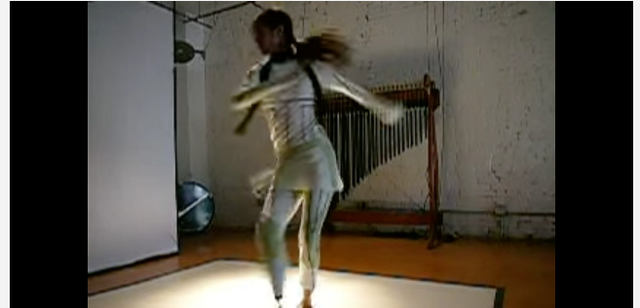
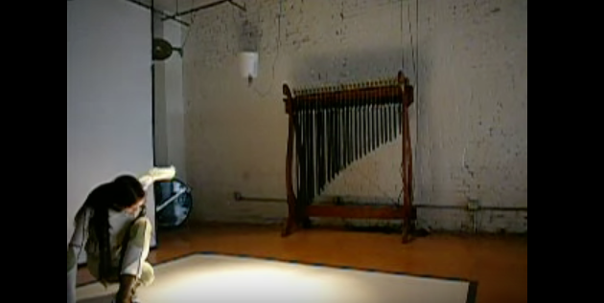
Interaction breakdown:
When the dancer bends her arm,
trigger a motor to hit the instrument with a mallet.
https://www.youtube.com/watch?v=OtKf9C0s6p8#t=30
A motor for each mallet hooked up to a circuit and your Arduino
A bend sensor MAPPED to trigger the mallet using the code in the Arduino IDE
input is mapped to output
Notes:
he played a huge role in remote control, induction motors, ac power, radio waves, xrays, wireless telecommunication,
http://theoatmeal.com/comics/tesla
When wireless is perfectly applied the whole earth will be converted into a huge brain, which in fact it is, all things being particles of a real and rhythmic whole. We shall be able to communicate with one another instantly, irrespective of distance. Not only this, but through television and telephony we shall see and hear one another as perfectly as though we were face to face, despite intervening distances of thousands of miles; and the instruments through which we shall be able to do this will be amazingly simple compared with our present telephone. A man will be able to carry one in his vest pocket.

Slide 22
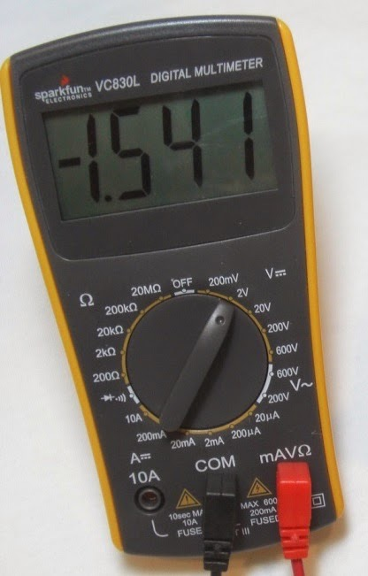
What is a multimeter?

Slide 23
SERIAL DATA
This is kind of line println() in processing in that it
lets you print out values
But totally different in that it’s actually a data
sending protocol. Things happen one bit at a time.
More detail here: http://www.ladyada.net/learn/arduino/lesson4.html
I like to think of it like shipping. It ships data to a
port on your computer other applications can go to and
there they can receive that data.
You call Serial.begin(baudrate) in setup() and the you can can Serial.write(value) in the loop()

Slide 24
SERIAL DATA
You’ll always want to check to see if you have any data available *BEFORE* you start reading it or you can
crash your computer

